Slide 1

Customer Review Dashboard

Slide 2
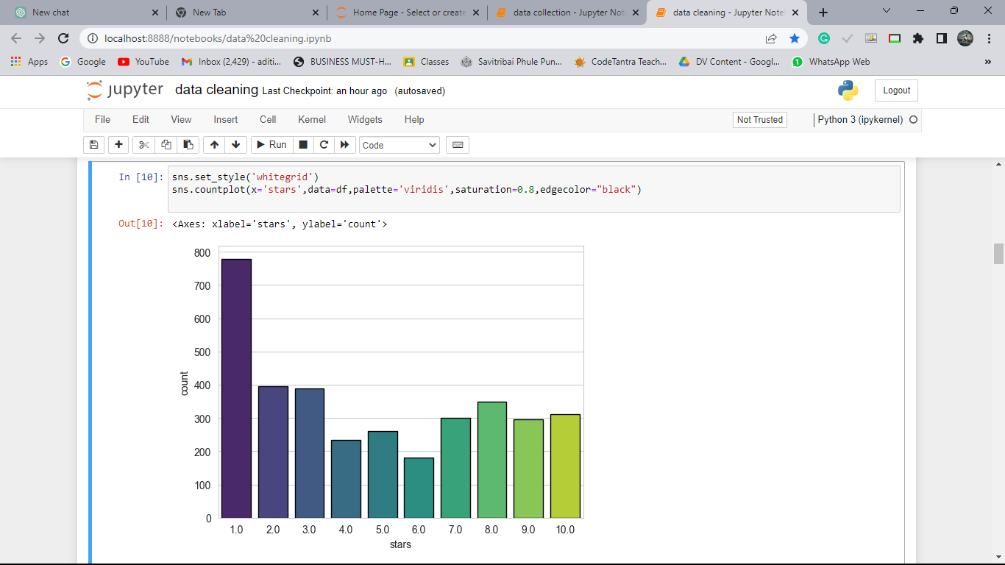
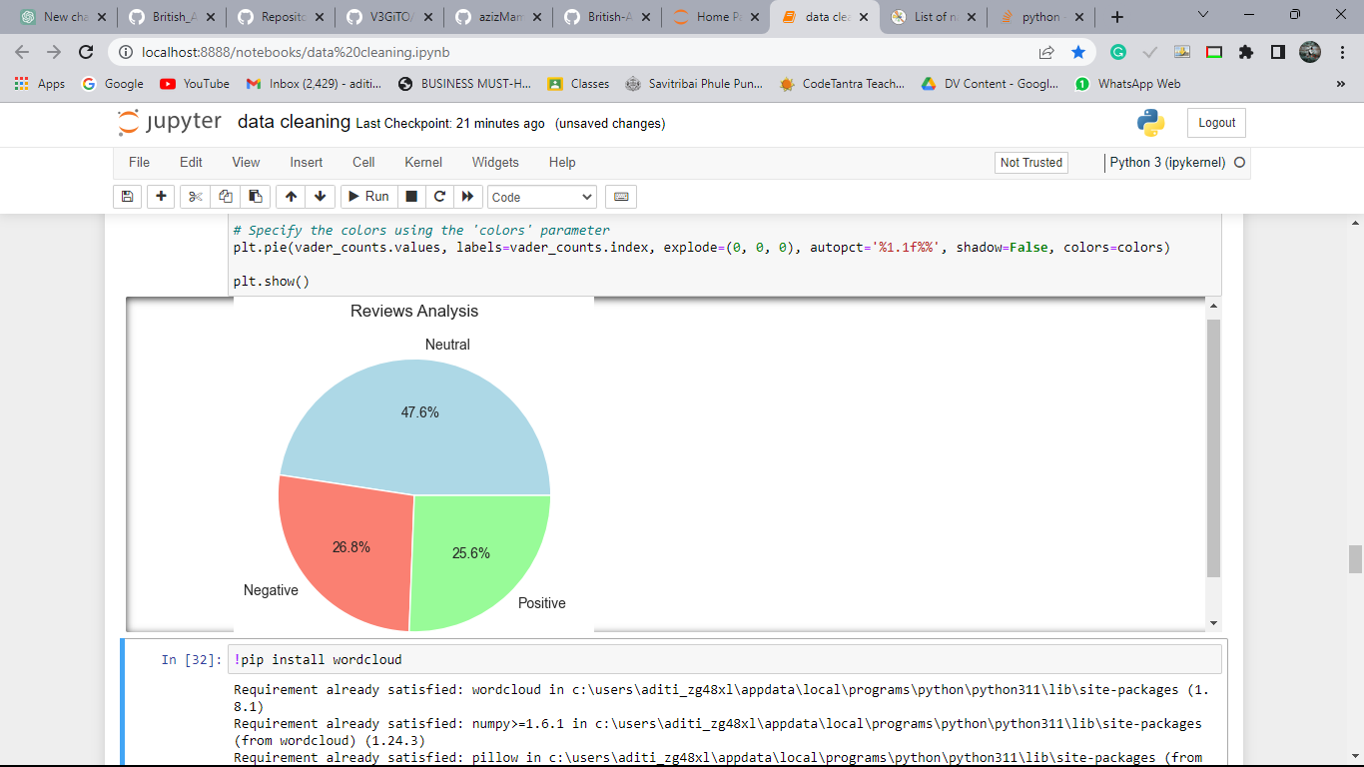
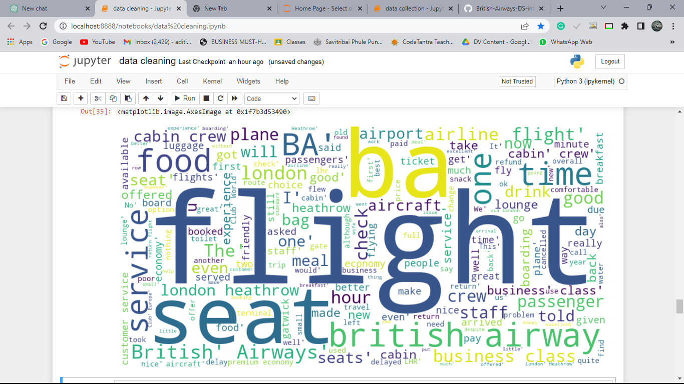
3500
Reviews
Distribution of stars
Word Cloud
896
POSITIVE
Reviews
938
NEGATIVE
Reviews
1666
NEUTRAL
Reviews

